Slide 1

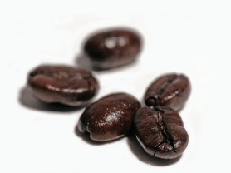
Encouraging Training Interaction
Presenter:
Robbie Bergstrom
Assistant County Clerk, County of Tuolumne

Slide 2




When I was in 2nd grade...
Who would like to be a chair lifter?

Slide 3


When I was in 2nd grade...
No, I didn’t say “chair lifter”, I said “cheerleader”.
OK, when performing, you want to remember to...

Slide 4



When I was in 2nd grade...

Slide 5
When I was in 2nd grade...
What did I learn?
Once you get my attention, I listen to every word.
When I understand what I am supposed to do, I follow better.
Some really cool dance moves!

Slide 6
When we train
Everyone trains
Helping a co-worker
Meetings with staffs
Speaking with the public
Preparing volunteers

Slide 7
When we train
A variety of people
I have had the opportunity to train a variety of:
  Subjects
  Ages
  Backgrounds

Slide 8
When we train
A variety of people
There will always be different types of people in a training.
Some people may feel less involved in the training then others.

Slide 9
When we train
A variety of people
As we know, many will lose focus if there not involved.
So how do you keep all these different types of people involved?

Slide 10
When we train
Three basic ideas
I’ve found there are 3 basic ideas to consider when creating a lesson within training.
When they are put together, it helps keeps participants involved.

Slide 11
What we will cover
Definition
Ways we learn
Explaining the “why”
Peaking our interest
The formula
Testing understanding

Slide 12

But first...
What’s your everyday superpower?

Slide 13
Definition
Interaction
Training interaction happens when a person becomes actively involved in a subject.

Slide 14
Definition
Expressed when..
They show an interest
They exchange of ideas or opinions
They ask and answer questions
They participate in activities

Slide 15
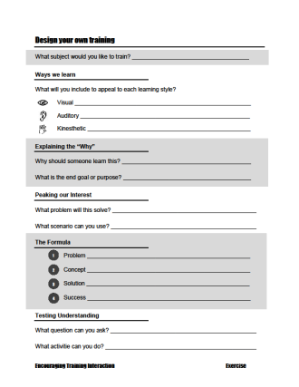
Design your own training
What would you like to train?
What subject have you always wanted to train?

Slide 16
Design your own training
What would you like to train?
It could be:
  Specific to your job
  A general skill
  A hobby you like

Slide 17
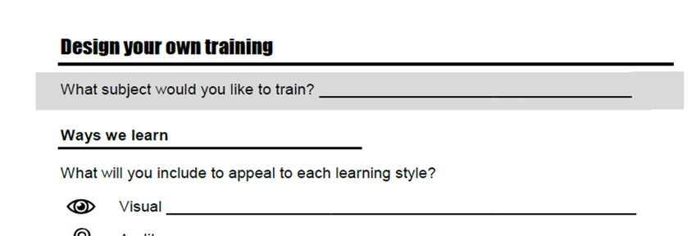
Design your own training
What would you like to train?

Slide 18


Ways we learn
Jessica’s story

Slide 19

Ways we learn
Jessica’s story
-5
-4
-3
-2
-1
0
1
2
3
4
5
2 – 5 =

Slide 20
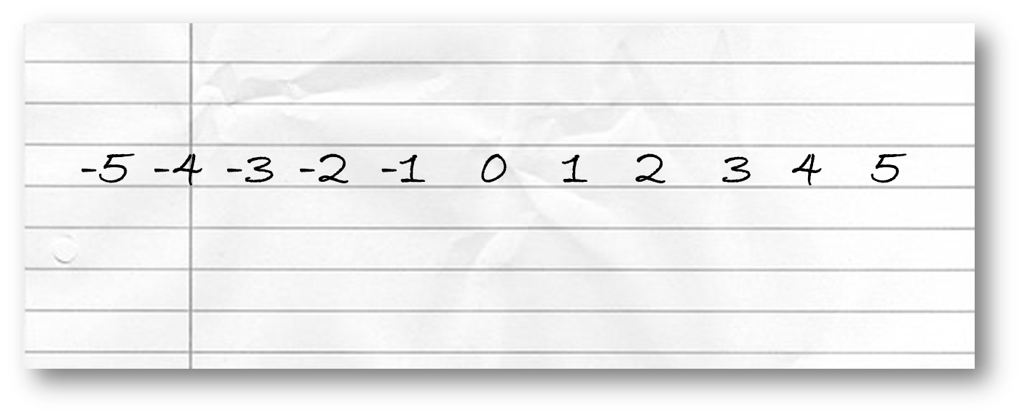
Ways we learn
Jessica’s story

Slide 21
Ways we learn
Jessica’s story
Although it’s the same concept, some understand better when presented in a different way.

Slide 22



Ways we learn
The way we learn and receive information is commonly grouped into 3 categories.
    Visual
    Auditory
    Kinesthetic

Slide 23
Ways we learn
Everyone has a mix of learning styles.
But most have a style that is dominant.

Slide 24
Ways we learn
Visual Learner
They may watch body language and facial expression to fully understand a topic.
They may visualize a story when listening.
They may learn best by watching something being done, pictures, diagrams, and illustrations.

Slide 25
Ways we learn
Auditory Learner
They may listen to tone of voice, pitch, and speed to fully understand a topic.
They may learn best with listening to explanations, discussion, and talking things through.

Slide 26
Ways we learn
Kinesthetic Learner
They may more often want to feel, move, and do in order to fully understand a topic.
They may learn best by using a hands-on approach and participating in an activity.

Slide 27

Ways we learn
One fun test

Slide 28
Ways we learn
One fun test
What type of learner are you?

Slide 29
Ways we learn
Checking your style
I recommend everyone take a quiz to better understand their learning style.
It will give you a good idea of how you prefer to learn.

Slide 30
Ways we learn
Checking your style
A 20 question quiz can be found at EducationPlanner.org
Every time I take this quiz, I receive the same score.

Slide 31
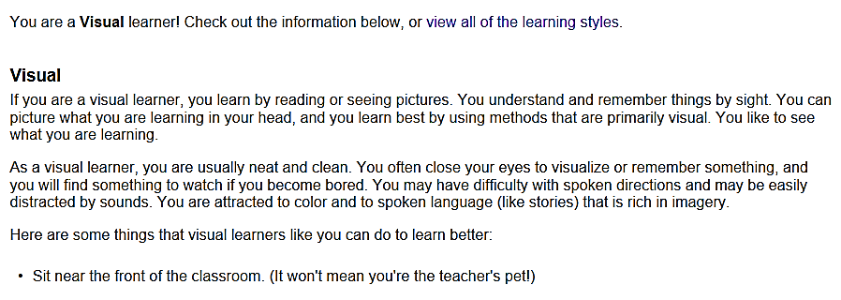
Ways we learn
Checking your style
  Visual: 50%
  Auditory: 30%
  Tactile: 20%

Slide 32

Ways we learn
Checking your style
I consider myself a “youtube mechanic”

Slide 33




Ways we learn
Checking your style
Demonstrating and Explaining
Just Demonstrating
The first step is to...
VS.

Slide 34
Ways we learn
It’s not an excuse...
I often hear this idea of learning styles used as an excuse.

Slide 35

Ways we learn
It’s not an excuse...
A participant after training complained we had not talked about a subject.
I said it a hundred times!
They must be a visual learner!

Slide 36
Ways we learn
Designing your training
You will always have participants with varying learning styles.
To make a training more effective, try to incorporate methods that appeal to all 3 learning styles.

Slide 37
Ways we learn
Designing your training
For the visual learner:
  Use a PowerPoint or write on the board
  Demonstrate
  Use body gestures

Slide 38
Ways we learn
Designing your training
For the auditory learner:
  Explain the process
  Tell stories
  Use details

Slide 39
Ways we learn
Designing your training
For the kinesthetic learner:
  Have an activity
  Use scenarios
  Use worksheets

Slide 40
Design your own training
What will you include?
What methods will you include to appeal to each learning style?

Slide 41
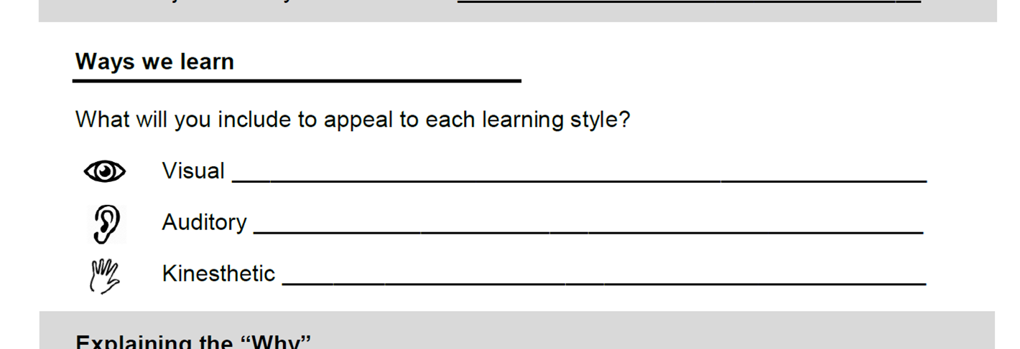
Design your own training
What will you include?

Slide 42
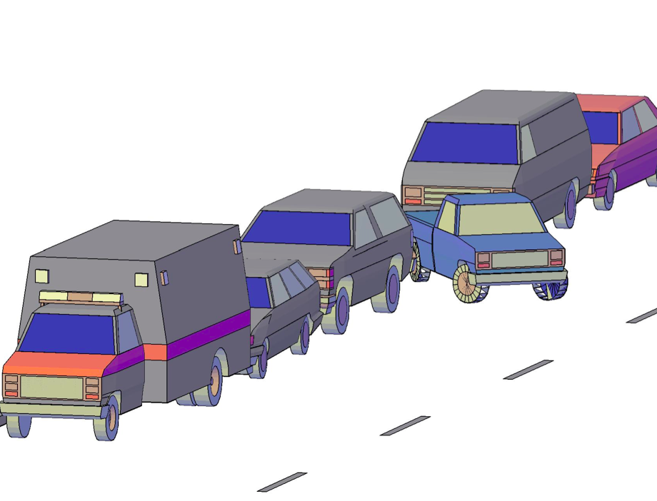
Explaining the “why”
Parallel Parking in Taipei

Slide 43
Explaining the “why”
Parallel Parking in Taipei
Only when you know the goal, can you know if you’re successful
Or at least if you’re on the right track

Slide 44
Explaining the “why”
Mindy from Animaniacs
A classic!

Slide 45
Explaining the “why”
Mindy from Animaniacs
video removed for size

Slide 46
Explaining the “why”
Mindy from Animaniacs
I was the child who always asked “why”.
I was more motivated and focused when I knew the reason.

Slide 47

Explaining the “why”
Concept first, then details
Imagine doing a puzzle without the picture on the box.
It would take you much longer.

Slide 48
Explaining the “why”
Concept first, then details
Explaining the reason why you are doing something gives a clearer picture of the goal.
Otherwise, they are just following steps.

Slide 49
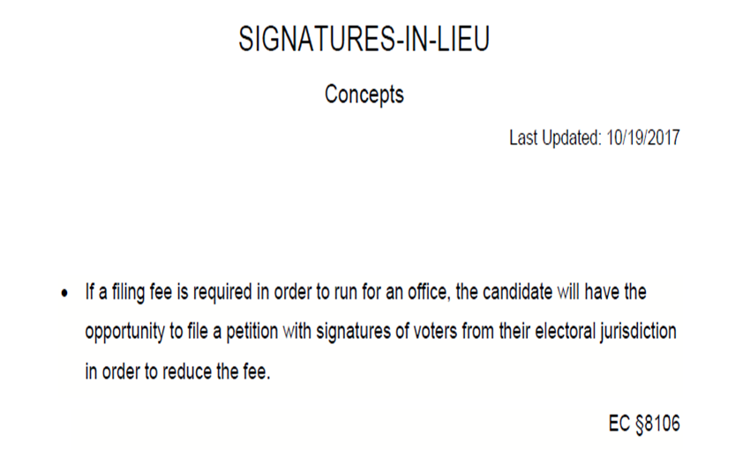
Explaining the “why”
Concept first, then details

Slide 50
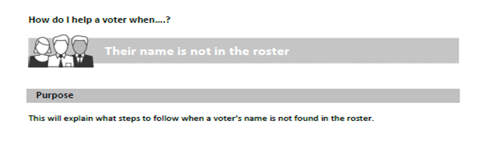
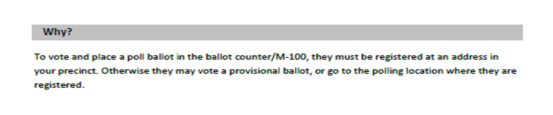
Explaining the “why”
Concept first, then details
Poll worker training handbook:

Slide 51
Explaining the “why”
Remembering and troubleshooting
A participant will not remember every step the first time.
Knowing “why” will help them think it through.

Slide 52

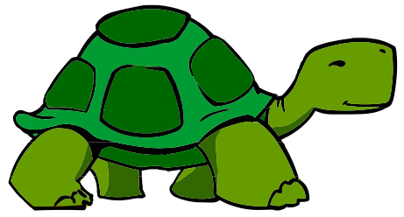
Explaining the “why”
Remembering and troubleshooting
Studying the martial arts
We are built like turtles!

Slide 53
Explaining the “why”
Allow them to improve the process
There is always more than one way to do something.
When someone understands the purpose, they may find a better way.

Slide 54
Design your own training
Explaining the “why”?
Why should someone learn this?
  Is it stated in code?
  Will it help a later process?
  Good for your health?

Slide 55
Design your own training
Explaining the “why”?
What is the end goal or purpose?
  What are you trying to accomplish?

Slide 56
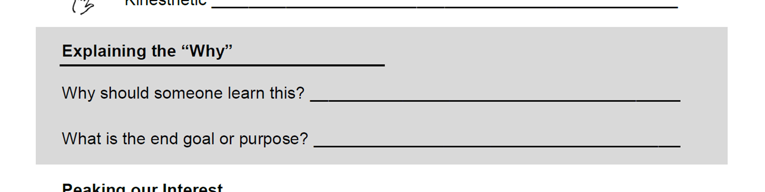
Design your own training
Explaining the “why”?

Slide 57
Peaking our interest
One of the most effective ways to peak someone’s interest is to give them a problem to solve.
Then give them the tools to solve it.
Many will be empowered and eager to use what they learned.

Slide 58
Peaking our interest
A Bounty Commercial
One of the great masters of catching our attention.

Slide 59
Peaking our interest
A Bounty Commercial
video removed for size

Slide 60
Peaking our interest
A Bounty Commercial
The disaster (problem)
The product (concept)
The cleanup (solution)
The smile (success)

Slide 61


Peaking our interest
Some examples
Does being broke disqualify you from running for office?
  Wow! I never thought about that.

Slide 62


Peaking our interest
Some examples
What would you do?
  Vote for Measure Y!

Slide 63


Peaking our interest
Some examples
How many words are there?
  It’s 22!
...As an attorney-at-law in Tuolumne County, I believe the City of Sonora has not yet reached 100% of it’s potential...
  No, it’s 17!

Slide 64







Peaking our interest
A superhero saves the day
Help!

Slide 65




Peaking our interest
A superhero saves the day

Slide 66

Peaking our interest
A superhero saves the day

Slide 67




Peaking our interest
A superhero saves the day

Slide 68
Peaking our interest
A superhero saves the day
The emergency (problem)
The danger (concept)
The rescue (solution)
The pose (success)

Slide 69

Peaking our interest
Teaching a technique
When teaching a technique, I always start with the danger.

Slide 70
Design your own training
How can you peak their interest?
What problem will they solve?
What scenario can you use?

Slide 71
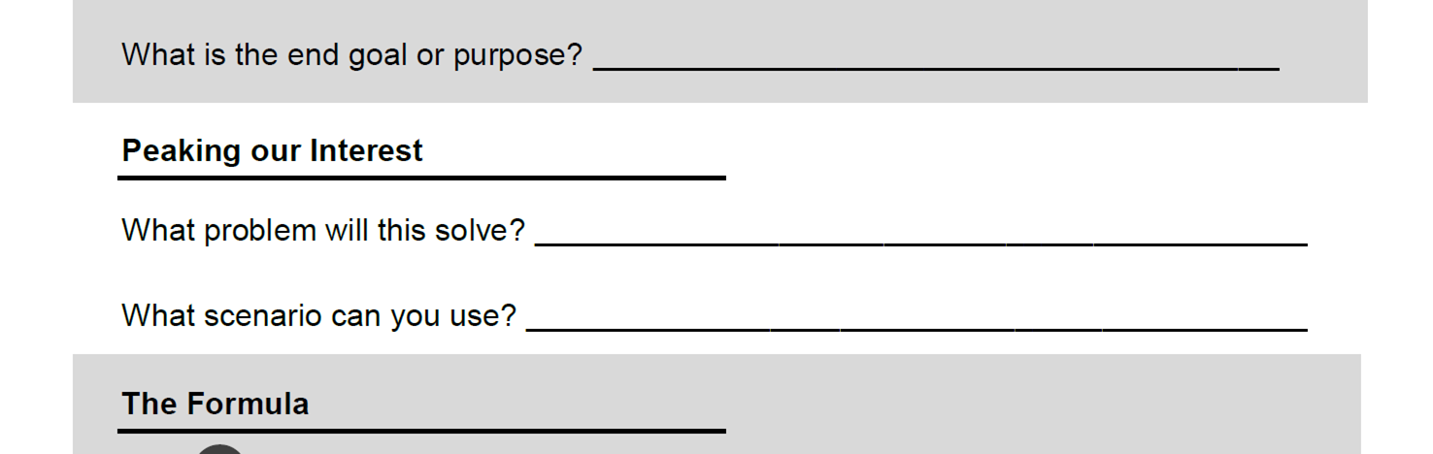
Design your own training
How can you peak their interest?

Slide 72
The formula
The 3 ideas
First peaking our participant’s interest
Explaining why we do something
Appealing to the different ways we learn

Slide 73
The formula
The 3 ideas
When you combine all of these ideas into a lesson, you will make a lesson within your training more interactive.

Slide 74
The formula
The 3 ideas
You will lead them to be more actively involved
And they will develop a better understanding

Slide 75
The formula
The 3 ideas
But how do you put it all together?

Slide 76
The formula
Putting it all together
For years I’ve used this simple formula
I have used it to give lessons within all types of trainings

Slide 77
The formula
Putting it all together
1
Present the problem
Remind them of the concept
Give them the solution
Opportunity for success
2
3
4

Slide 78
The formula
Putting it all together
1
Present the problem
  Ask a question or give a scenario
  Use a story to illustrate the problem
  Put it up on the board or PowerPoint
  Take some time to explain it

Slide 79
The formula
Putting it all together
2
Remind them of the concept
  Discuss the end goal, purpose, or idea
  Why do you have to solve the problem?

Slide 80
The formula
Putting it all together
3
Give them the solution
  Tell them the procedure or steps
  Show them how this solves the problem
  This should be explained and demonstrated

Slide 81
The formula
Putting it all together
4
Opportunity for success
  Give them a chance to practice
  Have them show you they understand
  Give them a similar question or scenario and see if they can figure it out

Slide 82
The formula
Some Examples
Random alphabet for names of candidates
  With staff

Slide 83
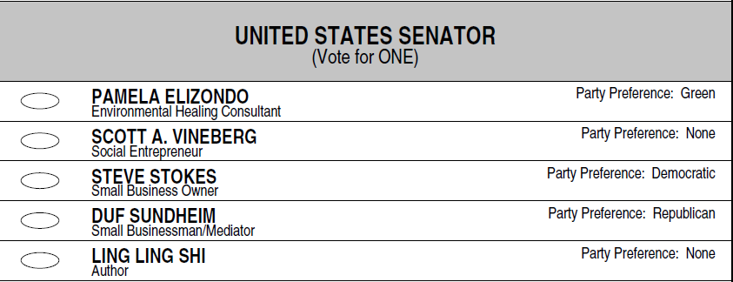
Random Alphabet
  How do we decide the order of candidates on the ballot?
1
Present the problem

Slide 84
Random Alphabet
  Both the SOS and County Elections office will draw a random alphabet.
  This will be used to determine the order of the names
2
Remind them of the concept

Slide 85
Random Alphabet
  The Random Alphabet is applied throughout the last name
  Than the first name
3
Give them the solution

Slide 86
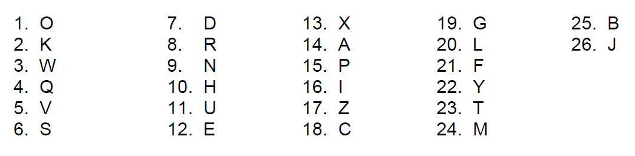
Random Alphabet
  November 2016 Random Alphabet
For example:
Lando Calrissian
James Chewbacca
3
Give them the solution
Padme Amidala
Han Solo

Slide 87
Random Alphabet
  Now you give it a try!
Betty Rubble
Fred Flintstone
Arnold Slate
Wilma Flintstone
Pebbles Flintstone
Barney Rubble
Joe Rockhead
4
Opportunity for success

Slide 88
The formula
Some Examples
Poll Worker Training
  With volunteers

Slide 89

Serving the voter/Regular duties
  What do I do when a voter comes in?
Hi! I’d like to vote.
1
Present the problem

Slide 90
Serving the voter/Regular duties
  What do I do when a voter comes in?
  One of your top responsibilities is to:
  Verify the person is a registered voter in your precinct
2
Remind them of the concept

Slide 91
Serving the voter/Regular duties
  What do I do when a voter comes in?
  Find their name on the roster and confirm the address
  Ask the voter to sign
  Update the street index
  Issue the ballot
3
Give them the solution

Slide 92
Serving the voter/Regular duties
  What do I do when a voter comes in?
  The participants use the sample roster we have provided in class and follow the steps.
Hello, my name is George Fotiu.
Can you please state your address?
15151 Redwood.
4
Opportunity for success

Slide 93
Testing understanding
Japanese Class
  “Maru”
  “Batsu”
  丸
  罰
  True
  False

Slide 94

Testing understanding
Japanese Class
  “Maru”
  “Batsu”

Slide 95

Testing understanding
Japanese Class
I did say the “right” answer
But, I didn’t know why

Slide 96
Testing understanding
Evaluating
The correct answer does not mean they understand

Slide 97
Testing understanding
Evaluating
Even if you have said it or shown it, they still might not get it.
You should always find ways to test and clarify

Slide 98

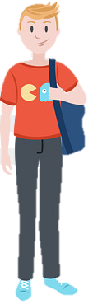
Testing understanding
Evaluating
  I want to make a boyfriend.

Slide 99
Testing understanding
Evaluating
You can:
  Ask questions
  Ask for clarification
  Use a scenario
  Do activities
  How...?
  Why...?
  What if...?
  Let’s give it a try!

Slide 100
Testing understanding
Evaluating
Give them time to answer

Slide 101

Testing understanding
Evaluating
“Happiness Lies in Contentment”

Slide 102




Testing understanding
Evaluating
  If you’re satisfied, your happy.
“Happiness Lies in Contentment”
  Oh, I like my job!
  Ugh! I hate that phrase! It’s just an excuse to stop trying.
  Ha! You’re not allowed to use that until your older.

Slide 103

Questions?

Slide 104
If you thought I was exaggerating…
video removed for size

